Slide 1

AI DATA CENTER OPERATIONS
CTCM
Content Tagging &
Competency Mapping
Team 2 / Capstone Track 7 / AIDC 2026
Noura, Hadeel, Shurooq, Duaa

Slide 2
Agenda
01
Introduction
05
Benchmark results
02
Architecture & pipeline
06
Observability & SLOs
03
Model deployment
07
Live demo
04
Evaluation
08
Conclusion
02

Slide 3
Business problem & CTCM use case
THE CHALLENGE
THE SERVICE OUTPUT
Learning content across multiple formats
Inconsistent topic and difficulty labels
Manual mapping to a skills taxonomy
8–12 topic tags
Difficulty level
4 competency mappings
Summary, confidence and 3 learning objectives
OBJECTIVE
Compare local GPU inference with an external API
using the same content and evaluation framework
03

Slide 4
System architecture
One FastAPI service with local and API-based inference
FASTAPI
Streamlit
File upload
Extraction
Text + images + OCR
3-pass orchestration
Inference + RAG
Structured
TagResult
Shared retrieval
bge-m3 on CPU
Qwen + vLLM
Local RTX A6000
GPT-4o-mini
External OpenAI API
POST /v1/tag/upload
Summary, tags, difficulty and skills
04

Slide 5
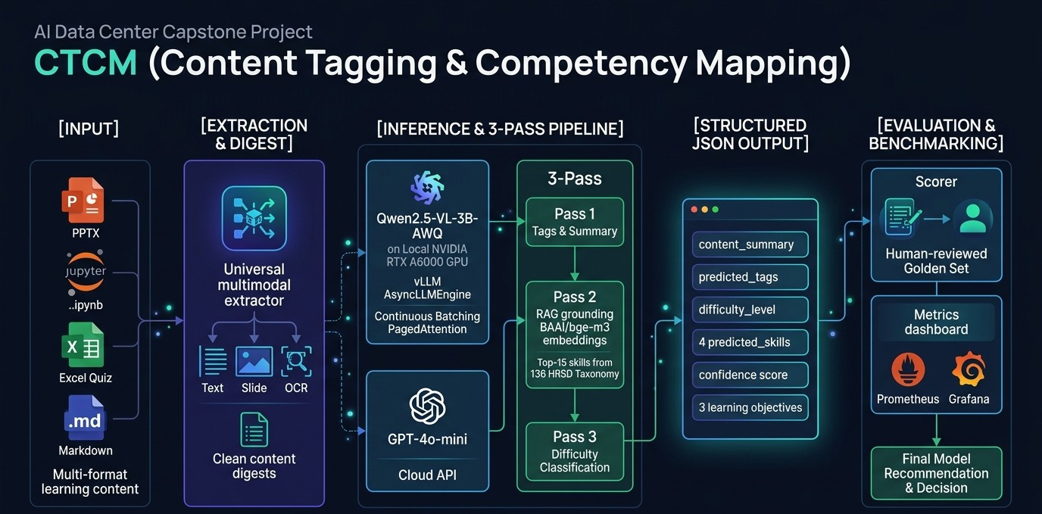
05

Slide 6
Three-pass inference pipeline
The same pipeline and output requirements for both models
PASS 1
PASS 2
PASS 3
Content analysis
Skill refinement
Difficulty refinement
Summary, topic tags
and initial skills
Retrieve candidates
then select final skills
Beginner, Intermediate
or Advanced
RAG SKILL REFINEMENT
136 taxonomy skills
Top 15 candidates
4 selected skills
Pass 2 runs when Pass 1 produces tags
06

Slide 7
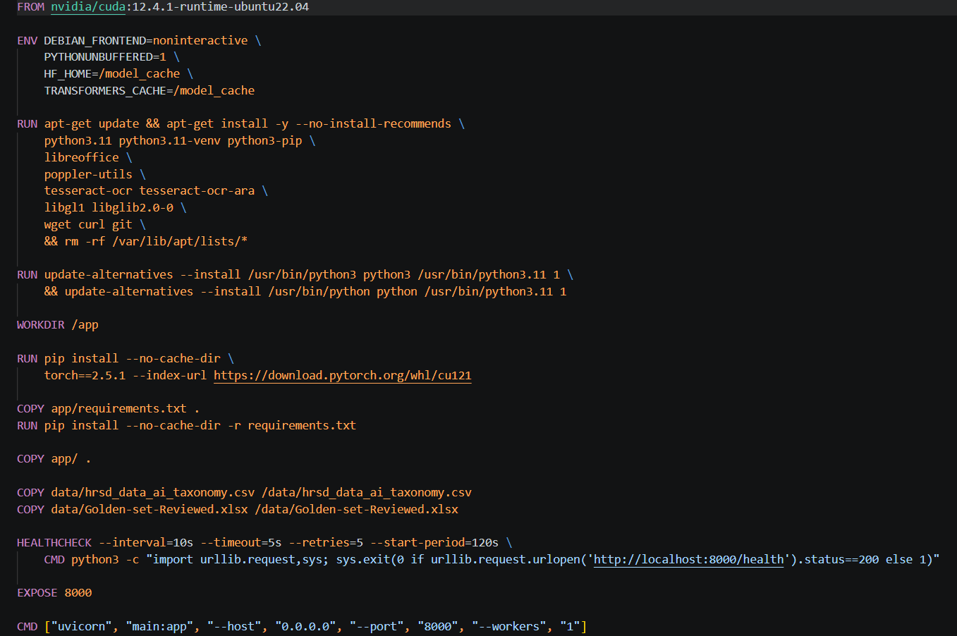
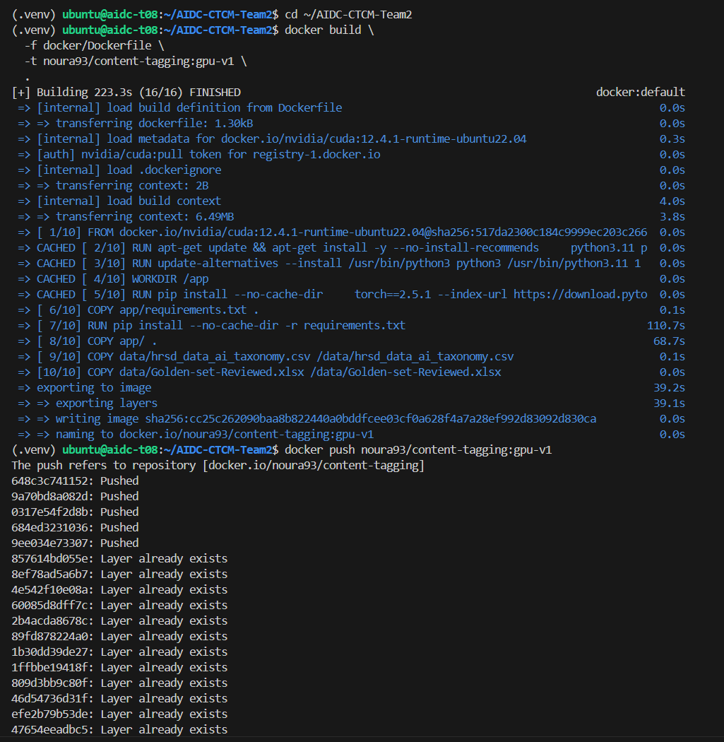
Model deployment: Image building
*Resource requests / limits. Recorded pod snapshot.
07

Slide 8
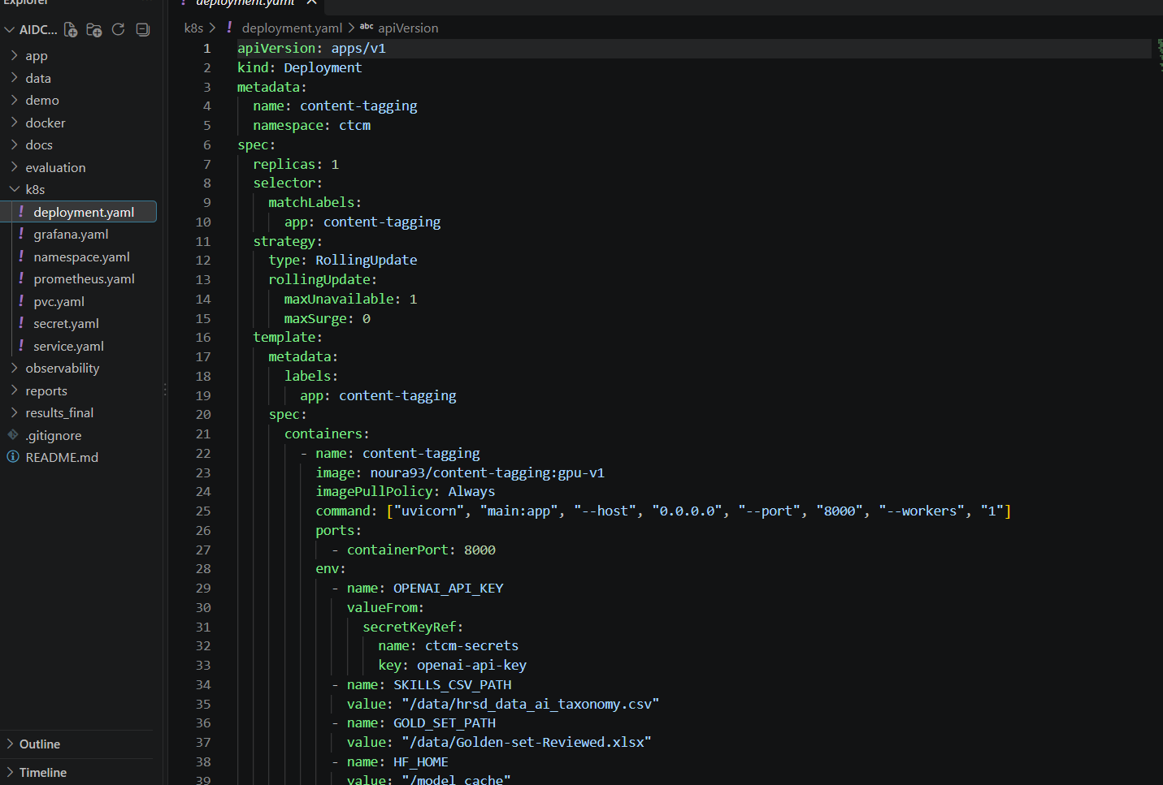
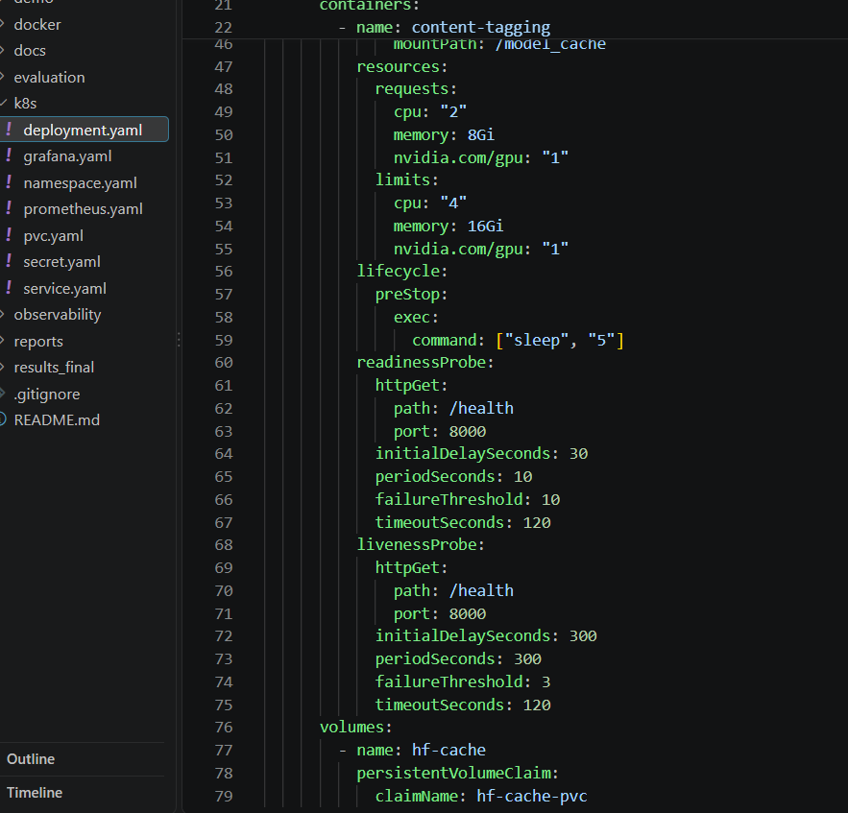
Model deployment on Kubernetes
*Resource requests / limits. Recorded pod snapshot.
08

Slide 9
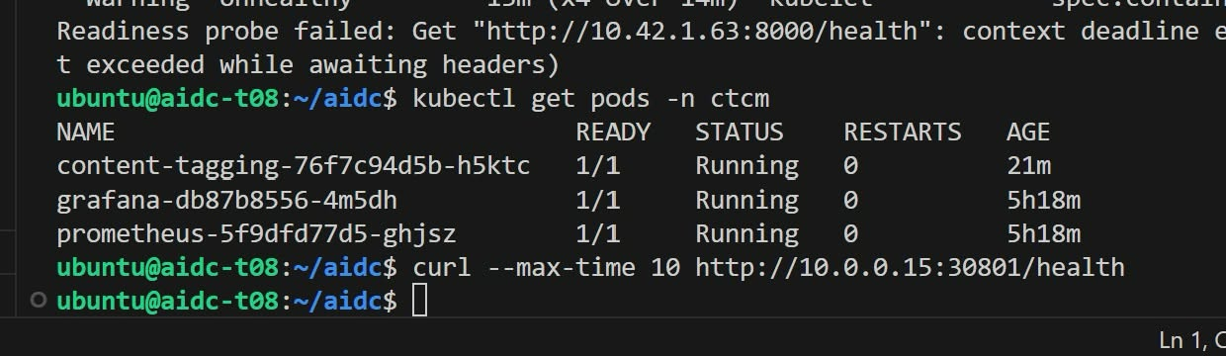
Model deployment on Kubernetes
Qwen2.5-VL-3B-Instruct-AWQ
vLLM AsyncLLMEngine
RTX A6000, 4-bit AWQ
8,192-token configured context
Docker + k3s
1 replica, 1 GPU, 1 Uvicorn worker
CPU 2 / 4 cores, RAM 8 / 16 GiB*
*Resource requests / limits. Recorded pod snapshot.
09

Slide 10
Golden Set & evaluation methodology
12
CONSISTENT COMPARISON
Same reviewed reference labels
Same pipeline and scoring logic
Predictions based on file content
human-reviewed files
.pptx .ipynb .xlsx .md
QUALITY + OPERATIONS
Python, machine learning,
SQL and data science
Tags, difficulty, skills, retrieval, validity
E2E latency, tokens, cost and load
10

Slide 11
Quality benchmark
GPT-4o-mini leads tagging and difficulty. Qwen leads skills mapping.
86.1%
RAG pool recall
both models
100%
Structural validity
benchmark checks
*Equal-weight mean of difficulty accuracy and strict tag Jaccard. 12 files per model.
11

Slide 12
Sequential latency, throughput & cost
Final 12-file benchmark
Average client E2E latency
 | Qwen | GPT-4o-mini
Est. files/hour | 63.8 | 50.0
Total tokens | 107,195 | 287,621
Exported cost per 1,000 files | $4.79 | $6.22
Cost estimates need reconciliation
The OpenAI export uses GPU-time costing in this endpoint.
Token totals also depend on each model’s tokenizer and multi-pass prompts.
12

Slide 13
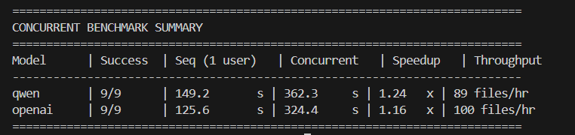
Concurrent load test
3 simultaneous users, each submitting the same 3 files in sequence
89
100
9/9
Qwen files/hour
GPT-4o-mini files/hour
successful requests
1.24× workload speedup
1.16× workload speedup
for each model
Mean request latency: Qwen 120.8 s / GPT-4o-mini 108.1 s
Separate from the 12-file benchmark. Each speedup uses its own 3-file baseline.
13

Slide 14
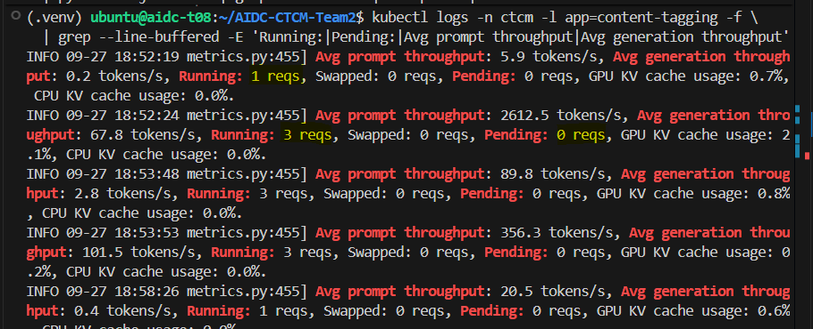
Continuous batching in Qwen
3
active inference
requests
0 pending in
this log snapshot
Prometheus: vllm:num_requests_running = 3
Async serving allows overlap while each file keeps its sequential pipeline
15

Slide 15
Observability with Prometheus & Grafana
APPLICATION
Both model paths
E2E latency, rate, errors
Prometheus
/metrics
15-second scrape
Grafana
Latency and load
Service health
vLLM ENGINE
Qwen only
TTFT, TPOT, queue, active requests
CAPTURED QWEN OBSERVATIONS
TPOT p95 ≈ 61.9 ms/token
Queue time p95 ≈ 60 s
16

Slide 16
SLIs & proposed SLOs
Measured service behavior against provisional capstone targets
Service indicator | Target | Observed evidence | Assessment
Scrape availability | ≥ 99% | Observed readings: 88–100%. Recorded 1-hour value: 94.2%. | Not met in observed 1-hour window Affected by restart/deployment activity
E2E latency p95 | ≤ 180 s per model | Approached ≈ 180 s | More evidence needed
Successful throughput | ≥ 50 files/hour per model | Qwen 89, GPT 100 files/hour | Met in test
Request error rate | ≤ 1% | 0/9 failures per model | Met in test Small sample
Qwen concurrency | ≥ 3 active without failure | 3 active, 9/9 success | Demonstrated
Availability uses scrape reachability. Short test windows limit service-level conclusions.
17

Slide 17
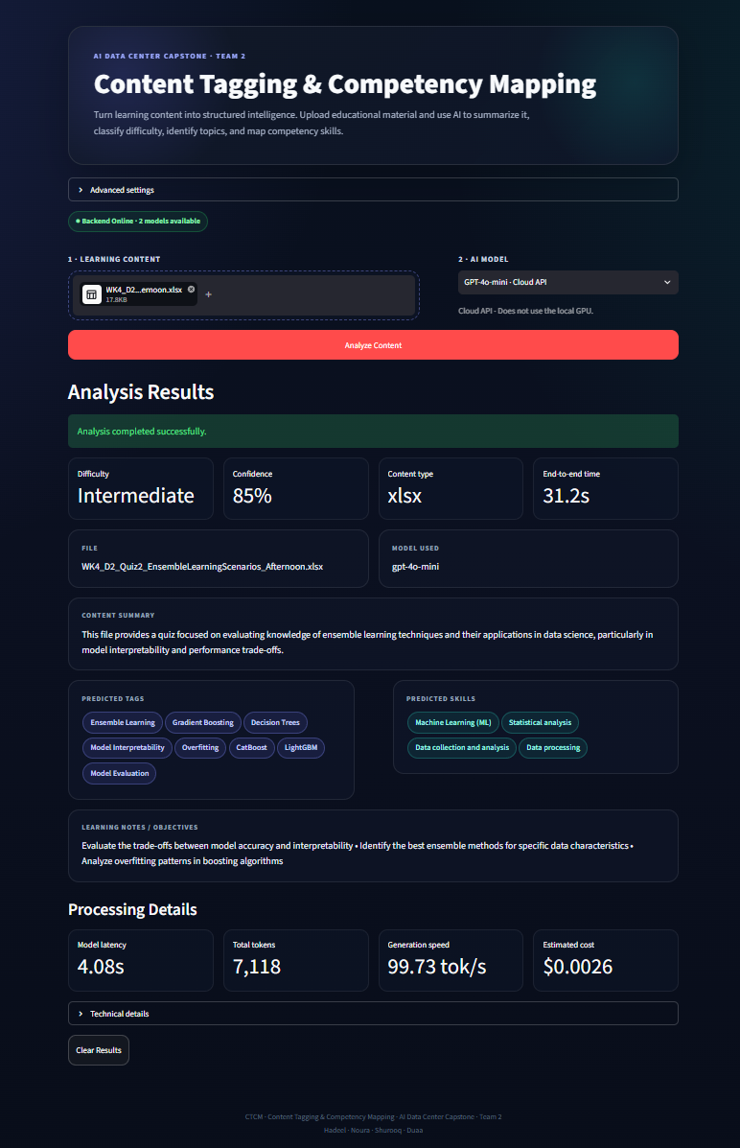
Live demo - Streamlit
Streamlit for content review, Grafana for service behavior
01
Upload a learning file
02
Select Qwen or GPT-4o-mini
03
Review tags, difficulty and skills
04
Watch Grafana during load
18

Slide 18
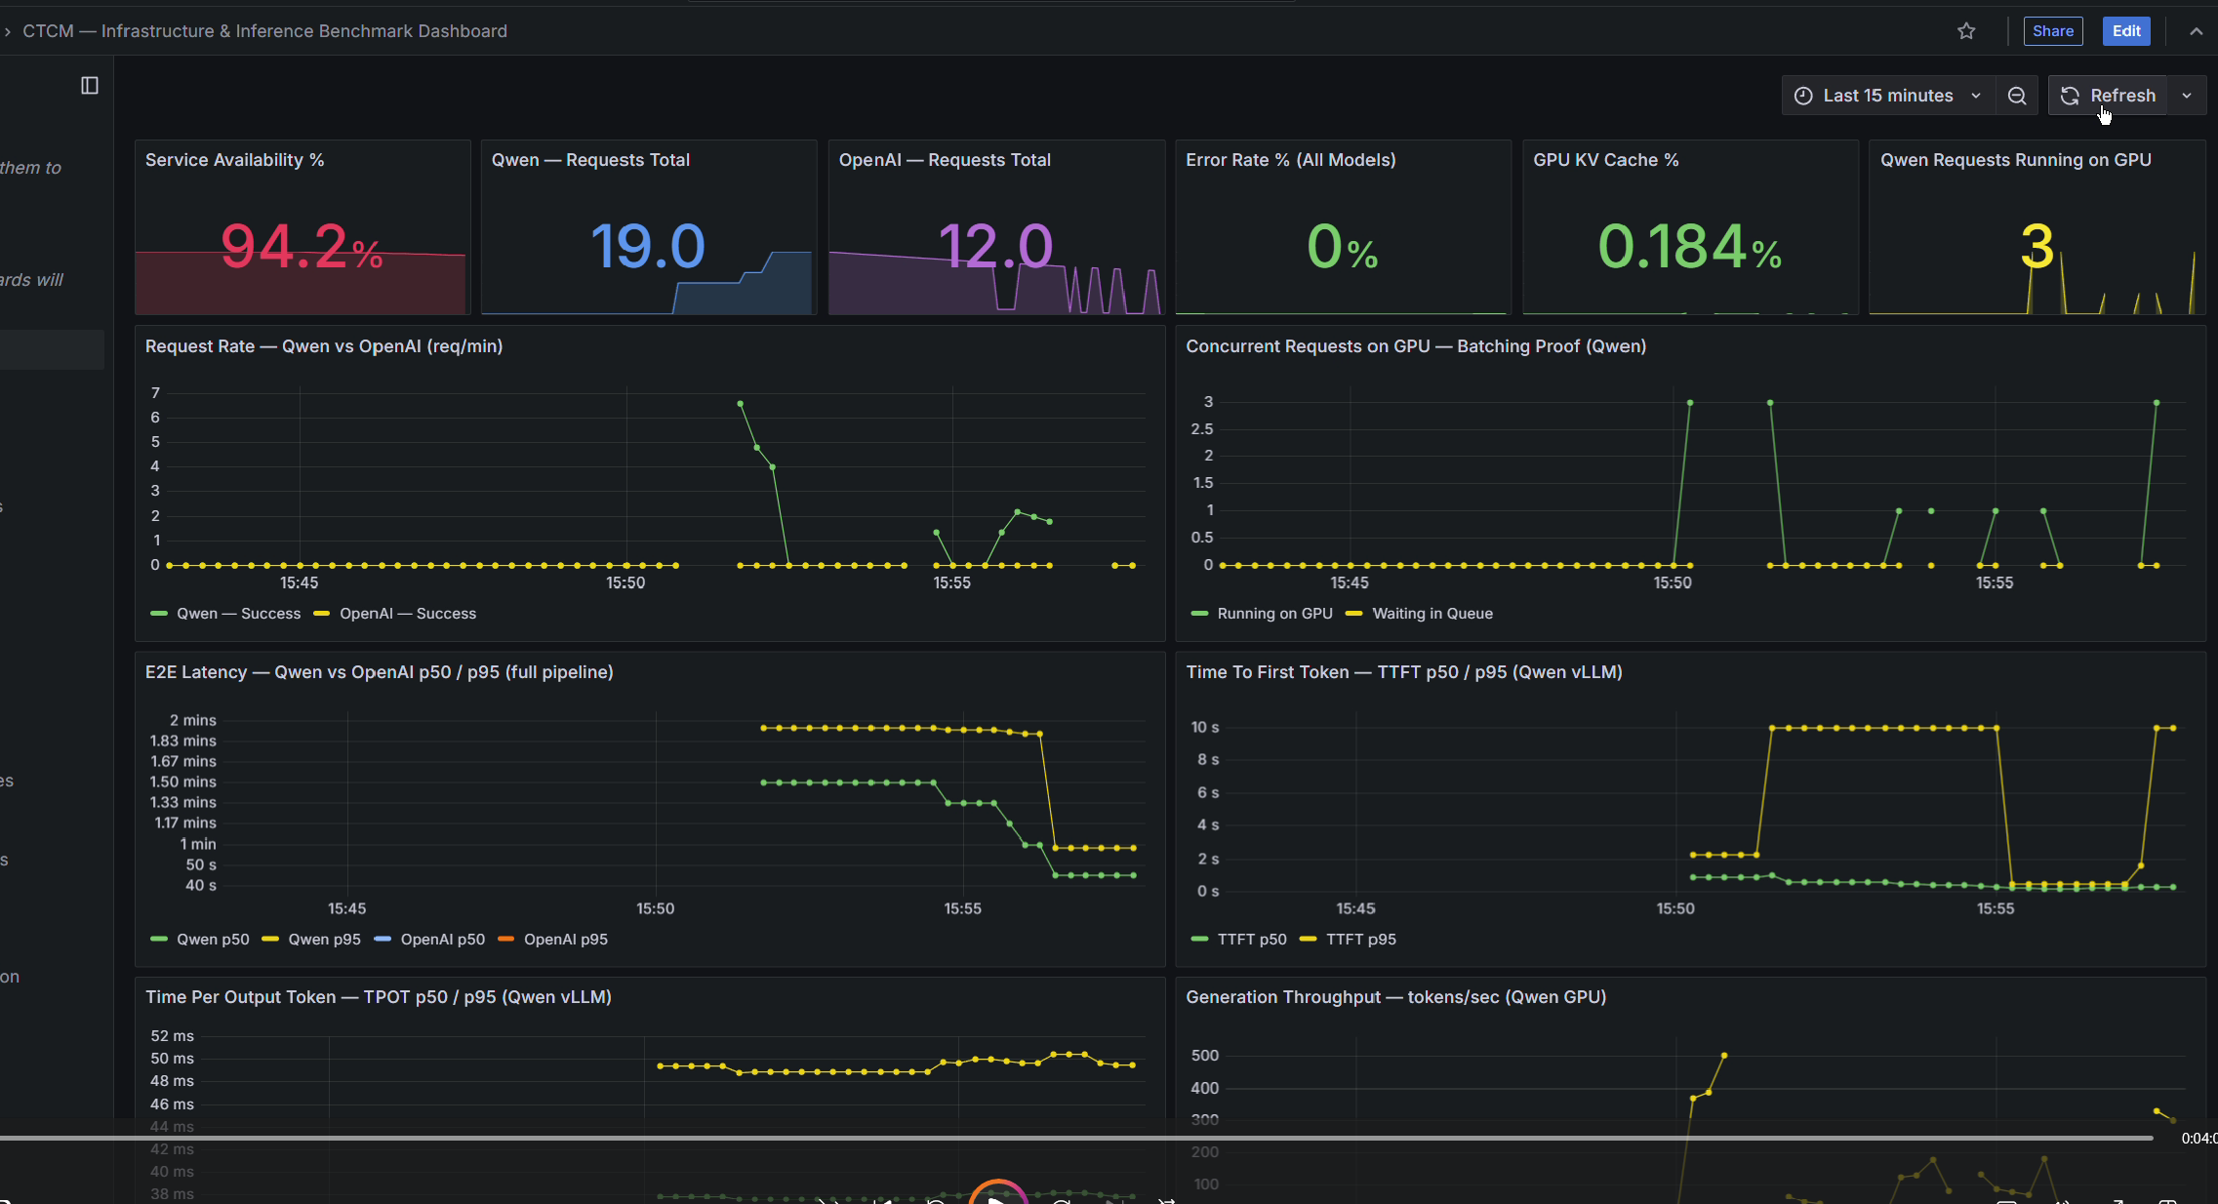
Live demo - Grafana
Streamlit for content review, Grafana for service behavior
19

Slide 19
Key findings & next steps
QWEN
GPT-4o-mini
Stronger skills mapping
Lower sequential E2E latency
GPU ownership and engine visibility
Stronger tagging and difficulty
Higher concurrent throughput
External API dependency
LESSONS
Async serving enables overlap. E2E and engine latency answer different questions.
PROPOSED NEXT
Larger load tests, cost validation, routing and scaling experiments
20

Slide 20
Conclusion
CTCM demonstrates an end-to-end AI infrastructure pipeline for automated content tagging and competency mapping.
Successfully integrated multimodal extraction, RAG, local GPU inference, and cloud API inference in one service.
Both Qwen and GPT-4o-mini produced 100% structurally valid outputs across the benchmark.
GPT-4o-mini showed stronger tagging and difficulty classification, while Qwen showed stronger skills mapping and lower sequential E2E latency.
The system successfully demonstrated concurrent inference, Kubernetes deployment, and real-time observability using vLLM, Prometheus, and Grafana.
The project highlights that model selection depends on both AI quality and operational requirements, not a single metric.
CTCM turns learning content into structured, measurable, and deployable AI intelligence.
Thank You — Team 2 | AIDC 2026
20

